Slide 1
Stock Trading Using k-NN and Technical Analysis:
A Case for Turkish Stocks

Slide 2
AGENDA
Literature Review
Technical Analysis
k-NN
Data
Model
Results
Conclusion
References

Slide 3
Literature Review
Teixeira, Oliveira (2010)
Computing an automatic stock trading method using nearest neighbor classifier (k-NN) together with technical analysis tools
Exclusively based on daily closing prices and trade volume from 15 real stocks from Sao Paulo Stock Exchange, also considering transaction costs
Profitability as key performance measure, buy-and-hold strategy as benchmark
Results:
Model performed better for 12 of 15 stocks while precision of classifier is relatively low (<50%)

Slide 4
II. Technical Analysis
Examines the market action by using charts for the prediction of future price movements
Principal sources: price and volume
Efficient Market Hypothesis
Moving averages
Relative Strength Index (RSI)
Stochastics
Bollinger bands
Notes:
Analyzation of the history of the prices is the necessary action
All past information is reflected in the prices and all the new information will be reflected in those prices immediately

Slide 5
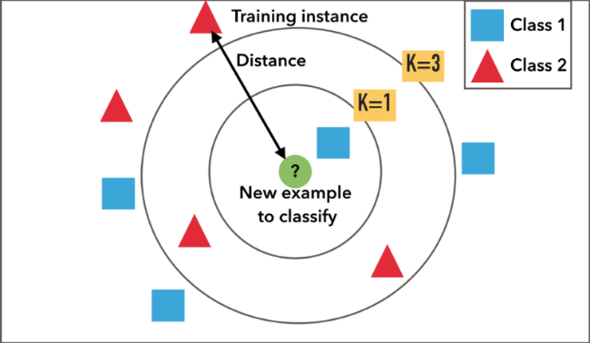
III. k-NN
The object belongs to the majority of its k nearest neighbors. Simply it works as follows :
Determining the value of k
Computing the distance between
the k nearest neighbors of the object
Assigning the class label as the
majority of the k nearest neighbors
Notes:
K-nearest neighbor classification aims to classify a new object by measuring similarities between other available objects, as known as its “neighbors”. A distance function, such as Euclidean, is used in order to measure the similarity.
K-value represents the number of neighbors that the algorithm uses to assign the object’s class. According to the algorithm, the object belongs to the majority of its k nearest neighbors. Simply its implementation works as follows :

Slide 6
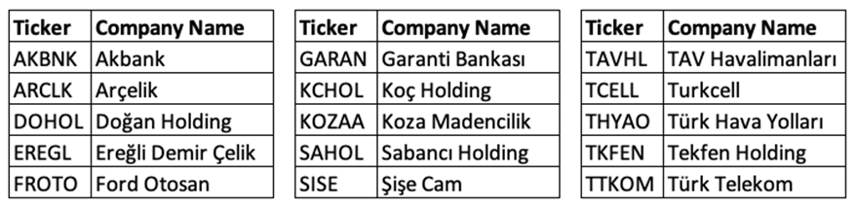
IV. Data
Obtained from EC581 course
15 stocks from BIST30 stocks, dated from 01/01/2009 to 31/12/2018
Consists of OHLC (Open, High, Low, Close) prices and volume of each stock for each day

Slide 7
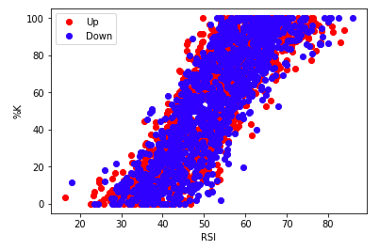
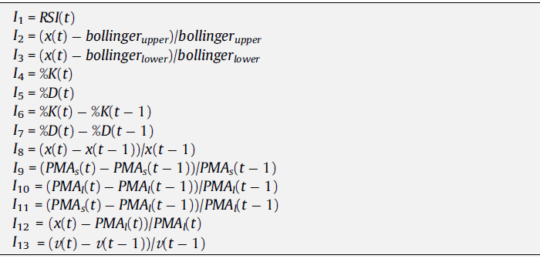
V. Model
Employ k-NN algorithm, k=13
Features are technical analysis indicators calculated from OHLC prices and volume data
Common technical analysis indicators

Slide 8
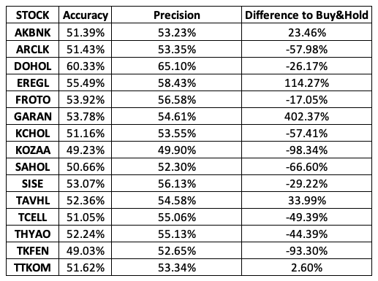
VI. Results
Evaluation Metrics
Accuracy
Precision

Slide 9
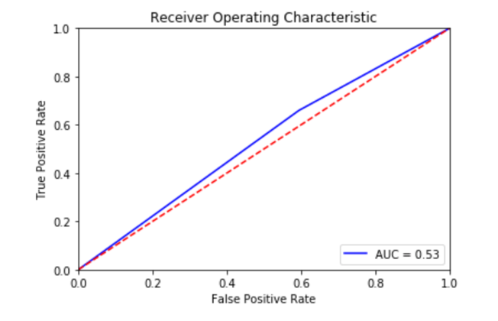
VI. Results
Evaluation Metrics
ROC and AUC
Degree of separability
ROC and AUC for GARAN

Slide 10
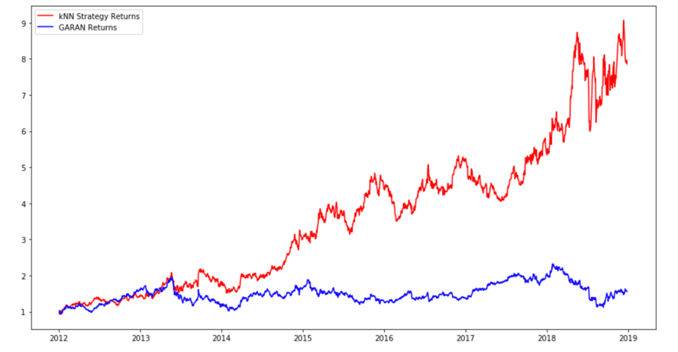
VI. Results
Final Returns
Cumulative Returns
Cumulative Return of GARAN for both the model and the buy & hold strategy

Slide 11
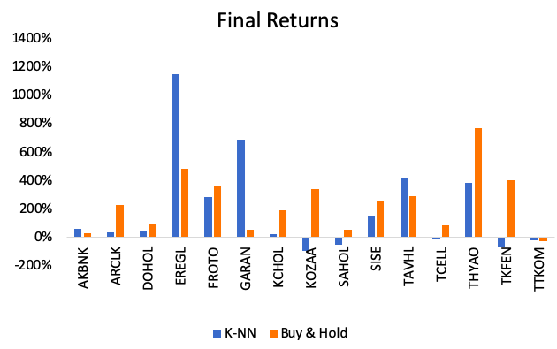
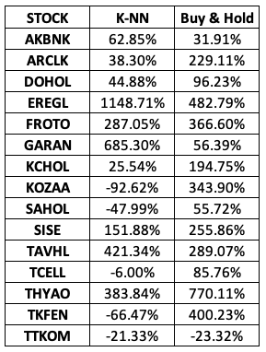
VI. Results
Final Returns
End equity and return

Slide 12
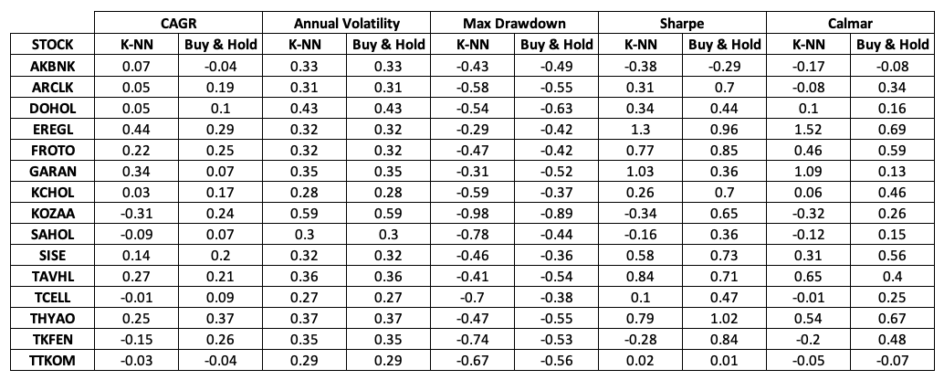
VI. Results
Financial Metrics

Slide 13
VII. Conclusion
Is k-NN model feasible in Turkey Stock Exchange Market?
Predictability and separability
Returns and financial metrics
Optimal k-value ?
Further research
Worth to invest ?

Slide 14
VIII. References
Aha, D., Kibler, D. and Albert, M. (1991). Instance-based learning algorithms. Machine Learning, 6(1), pp.37-66.
Alkhatib, K., Najadat, H. and Hmeidi, I. (2013). Stock Price Prediction Using K-Nearest Neighbor (kNN) Algorithm. International Journal of Business, Humanities and Technology, 3(3), pp.32-44.
Murphy, J. J. (1999). Technical analysis of the financial markets. New York Institute of Finance.
Teixeira, L. A., & De Oliveira, A. L. I. (2010). A method for automatic stock trading combining technical analysis and nearest neighbor classification. Expert systems with applications, 37(10), pp.6885-6890.
Theofilatos, K., Likothanassis, S., & Karathanasopoulos, A. (2012). Modeling and trading the EUR/USD exchange rate using machine learning techniques. Engineering, Technology & Applied Science Research, 2(5), pp.269-272.

